Slide 1
DSA4211 Presentation
Group 1:
Chua Kang Wei
Frederick Liew Yong Lun
Lee Yong Jie, Richard
Nicholas Alexander

Slide 2
Introduction
In the hotel industry, it is a common problem to match the needs of the customers to the limited rooms available in the hotel.
Customers may book for a stay in advance and cancel it thereafter, potentially costing the company time/effort preparing for their reservation
If we are able to predict if a particular customer will cancel or not, it will allow the company to make better decisions on their resource allocation

Slide 3
The dataset
'Hotel booking demand' dataset from Kaggle
https://www.kaggle.com/jessemostipak/hotel-booking-demand
Raw: n = 119390, p = 31

Slide 4
The dataset
Contains information with regards to the details of each stay
Arrival/duration time
Number of people involved
Meals
Customer type
Room type assigned
Whether the customer is checking in as part of a company
Etc.

Slide 5
The dataset
5 rows were dropped
NA values
1 predictor was dropped
Correlated to the label of the dataset
Final dataset of n = 119385, p = 30

Slide 6
Problem statement
"Given the numerous attributes that come with each booking, is it possible to predict if the particular booking is cancelled?"

Slide 7
Sure Independence Screening
SIS (Lasso) was run on the initial dataset
A set of 9 of the more significant variables were obtained
Lead time
ADR
Required car parking spaces
Total of special requests
Market segment (Groups / Offline TA TO)
Deposit type (Non Refund)
Agent (240)
Customer type (Transient Party)

Slide 8
Training/test split
A 80/20 split for the training and test set was then employed
Training: n = 859572, p = 9
Test: n = 214893, p = 9
Utilized for the subsequent methods

Slide 9
Methods used
Logistic Regression
K-Nearest Neighbours
Decision Trees

Slide 10
Logistic Model
Logistic model was fitted using the features selected from SIS-lasso
log (p(x))/(1-p(x))=-9.159+0.00348*lead time+0.01147*country+0.472*market segment+0.5532*reserved room type-0.5496*assigned room type+3.983*market segment offline TA TO+0.0051583*deposit type non refund-0.1783 required car parking space-0.6067*customer type transient party
All variables are significant except for required car parking space with AIC value of 84888

Slide 11
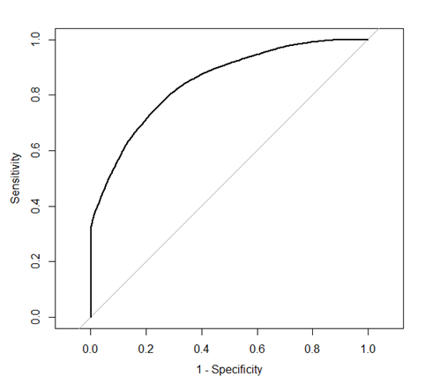
Logistic Regression
ROC curve was observed with an AUC of 0.82
We assumed that the cost of classifying false positive and false negative are the same, we maximize both the sensitivity and specificity

Slide 12
Logistic Regression
Youden's J statistic were used to select the best cutoff for classification
J = sensitivity + specificity - 1
The optimal threshold that maximize the sum of sensitivity and specificity was 0.36
The threshold is chosen purely from the train set without any data snooping on test set

Slide 13
Logistic Regression
Tuning threshold using train set
Is_canceled = 0 as the positive case
Sensitivity = 0.77
Specitivity = 0.745
Best threshold chosen at 0.36
Proportion of 0 and 1 in the training set is 0.629 and 0.371
pred\train | 0 | 1
0 | 46359 | 9036
1 | 13680 | 26433

Slide 14
Logistic Regression
Test Set Result
Is_canceled=0 as the positive case
Sensitivity =0.77
Specitivity=0.745
Proportion of 0 and 1 in the training set is 0.633 and 0.367
Logistic regression model is moderately accurate with high sensitivity and specificity and test accuracy of 76.05%
pred\test | 0 | 1
0 | 11642 | 2235
1 | 3484 | 6516

Slide 15
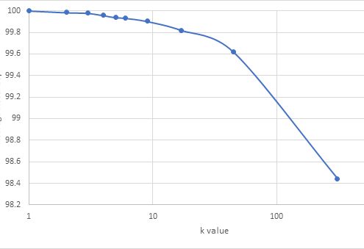
K-Nearest Neighbours
Cross-validation used to find optimal k
k values selected from roots of population size

Slide 16
K-Nearest Neighbours
 |  | Actual Outcome
 |  | Not cancelled | Cancelled
Predicted outcome | Not cancelled | 15012 | 2
 | Cancelled | 2 | 8861
Final accuracy rate of 99.983%
Very low false positive and false negative rates

Slide 17
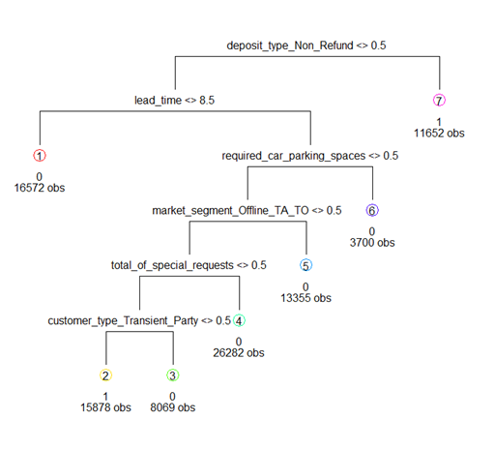
Decision Trees
A decision tree was fitted on the dataset using entropy as the splitting method.
A total of 6 variables were used in tree construction.

Slide 18
Decision Trees
Another decision tree was fitted using Gini index as the splitting method.
Resulting tree contains 71 terminal nodes which is much higher than 7 terminal nodes when entropy was used.
The complexity of the tree is much higher, which makes it much hard to interpret, even though the training error rate is slightly lower at 0.212 instead of 0.218 when entropy was used.

Slide 19
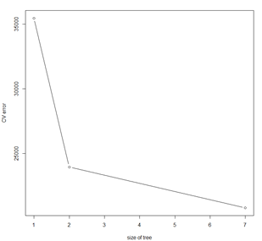
Decision Trees
We checked if there is a further need to prune the decision tree that relied on entropy.
We used cost complexity pruning and 10-fold cross-validation to determine optimal tree complexity level.
As seen in the graph, the cross-validation error was lowest at size = 7.

Slide 20
Decision Trees
As such, the best tree is the original tree fitted using 'entropy'.

Slide 21
Decision Trees
Confusion matrix for training data |  | Actual Outcome
 |  | Not cancelled | Cancelled
Predicted Outcome | Not cancelled | 53607 | 14371
 | Cancelled | 6432 | 21098
Confusion matrix for test data |  | Actual Outcome
 |  | Not cancelled | Cancelled
Predicted Outcome | Not cancelled | 13508 | 3528
 | Cancelled | 1618 | 5223
Training error is 0.218
Test error is 0.216.
This suggests that there is minimal overfitting or underfitting.
Misclassification rates are much higher than KNN.

Slide 22
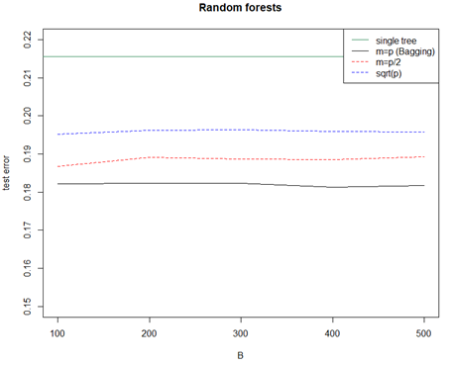
Decision Trees
We attempted random forests on the tree using B = 100 to B = 500 decision trees.
Using m=p, bagging produced the smallest test error at around 0.182.
Using m=p/2 produced test error at around 0.188 to 0.19
Using m=sqrt(p) produced test error at around 0.195.
As such, Bagging seems to be the best method and it was also observed that increasing B further did not reduce the test error significantly.
However, bagging has much longer runtimes, which leads to higher computational costs, this will be explained later.

Slide 23
Summaries of results - Accuracies
Method​ | Test accuracies
Logit​ | 76.04%
KNN | 99.983%
Decision tree​ (Entropy) | 78.4%
Random forest (Bagging)​ | 81.8%

Slide 24
Comparison of results – Runtime
Method | Runtime (seconds)
Logit | 1.23
KNN (10 'K' values * 10 folds/K) | 333.8
KNN (One run) | 22.68
Decision tree (Normal) | 0.41
Decision tree (Gini) | 0.71
Decision tree (Pruning) | 5.02
Random forest (3 * 5 runs) | 280.34

Slide 25
Conclusion
Various models were fitted to try to predict whether a particular booking will be cancelled
KNN performed the best
Largely due to the high n involved
At the drawback of possibly an extremely long runtime
Random Forest did moderately well
But with a significantly long runtime as well
Logit models and decision trees don't do so well
However, they run nearly instantly

Slide 26
Conclusion
Overall, predicting if a particular booking will be cancelled can be done with a very high accuracy
Certain variables may not be immediately available to us right from the start
There may also be a different system for booking in the local context, and these methods may not work as well when applying to other datasets

